Slide 1
Visualising Ant Colony Optimisation
Major Project
Christopher Edwards

Slide 2
Aims of the Project
Provide a visual representation of an Ant Colony Optimisation algorithm
To be used in an educational environment
Teaching resource
The algorithm’s parameters can be changed by the user
Number of cities
Number of ants
Alpha value
Beta value
Decay rate
etc

Slide 3
Ant Colony Optimisation
Family of Swarm Intelligence methods
SI typically involves a population of simple agents
Probabilistic path finding technique
Return the optimal path in a graph
Based on real-world ant behaviors
Ants always find the shortest path between nest + food
Work together based on pheromone trails
Currently this project focuses on the TSP
Travelling salesman problem

Slide 4
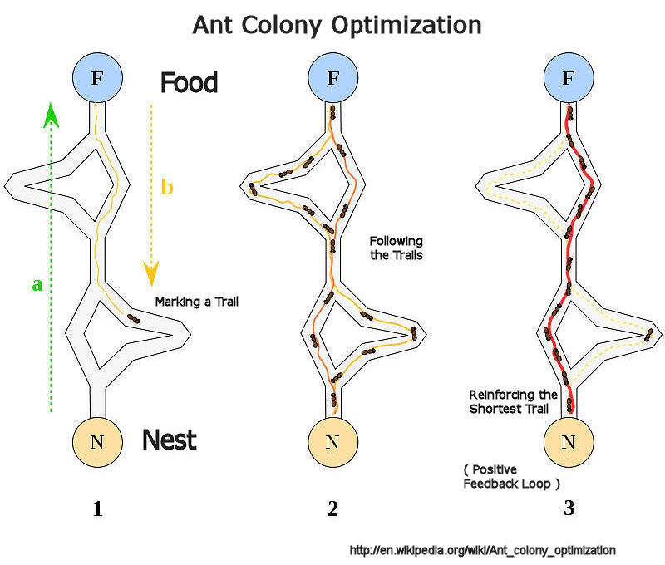
Image: http://s158.photobucket.com/user/OnlyObvious/media/ants/Aco_branches_svg_800_Notes.jpg.html

Slide 5
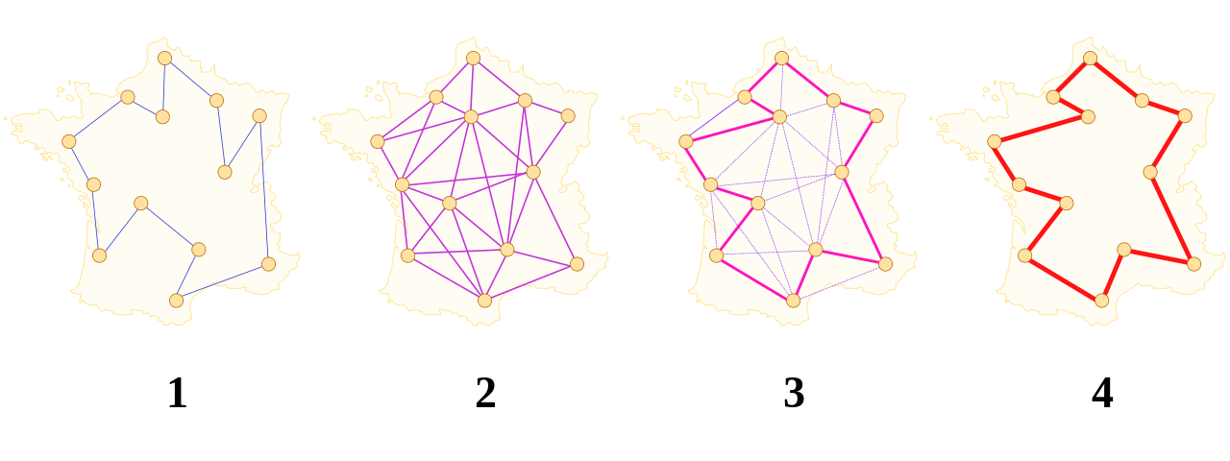
Image: http://upload.wikimedia.org/wikipedia/commons/thumb/2/2a/Aco_TSP.svg/1280px-Aco_TSP.svg.png

Slide 6
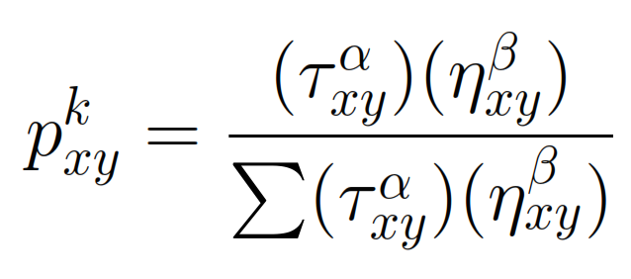
Probabilistic property
An agents next location is calculated using the following probability:
α: Meta heuristic value relating to the favoring of pheromone
β: Meta heuristic value relating to the favoring of shorter distance
η: 1/distance from current to node xy

Slide 7
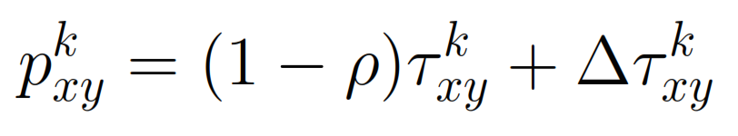
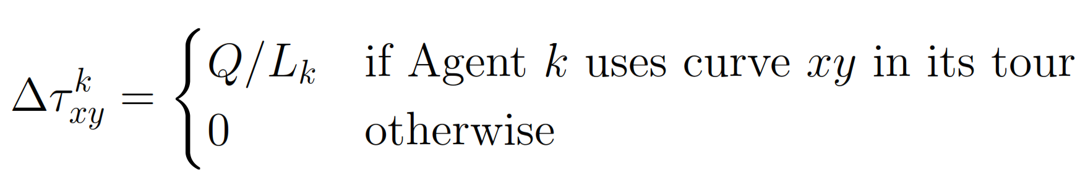
Pheromone deposit
The pheromone trails are updated as the agents traverse the graph
The equation to model this behavior is:
This correctly factors in decay and allows for any ant moving through node xy to add to the pheromone concentration at node xy

Slide 8
Technical Implementation
Implemented in Java and its Swing packages
Cross-platform
JUnit tests
Visualising the algorithm is difficult
Easy to implement, difficult to visualise
Showing pheromone levels to the user
Showing the agents moving
Show the best route
Do all this in a reasonable time

Slide 9
Technical Challenges
Use of SwingWorker to execute the algorithm in its own thread
Allows updates of the view without it ‘freezing up’
Simulate ants moving on the ‘paths’
Get the location the ant started and its destination
Use linear interpolation
Given the x /y co-ordinate of the start and finish
get the value of any x/y co-ordinate on the path between these two points
value1*(1-μ)+value2* μ);
value1/2 is the X or Y value (e.g value1 = start x, value2 = destination x)
μ is how far on that path you want (e.g μ 0.5 = half way between the points)

Slide 10
Current algorithm
To update the view to reflect the current state
For every ant(agent)
Draw the ant at their current location
If they aren’t finished, move them
During this move, get their current X and the destination
Linearly interpolate these two locations to show the ant moving
Update pheromone
If the ant has the current best path, set its path as best
Loop through the cities visited in order and draw a line between them
paint the updated pheromone
Once all ants have finished
Remove all pheromone trails and only show the best path
This is the general form there are other intricacies

Slide 11
Future work
Display how many ants are at each city
Currently shows 1 ‘ant’ regardless
Experiment with correct limits to add to text fields
Potentially add variations of the algorithm
Elitist ants, Min-Max system etc.
Test the application thoroughly
Potentially set up an nest-food style of problem
Potentially extend the application to visualise BCO as well

Slide 12
Demonstration
Current features:
load configurations from a file
Save configurations to a file
Set the speed
Modify algorithm parameters
Error checking on all fields
Display the best route and distance
See the ants move
Visualise pheromone

